Slide 1
Reading Makes A Difference
(And you can, too!)
By Dana Kerins, Courtney Folkes, Kristi Wilson, and Kaylee Dougherty

Slide 2
about us
We, Courtney, Dana, Kristi, and Kaylee, are all Students attending Boise State University majoring in Health Promotion and Education. This semester we have had the wonderful opportunity to work with Sherry Iverson in drafting a needs assessment to grasp more knowledge on early childhood literacy in Idaho for our Community Health Course. We created, distributed, and analyzed surveys in order to provide valid and helpful recommendations for our presentation. We hope our recommendations will be a great source for the Pediatricians of Idaho.
Notes:
Kaylee

Slide 3
What we Researched
Article 1 : From ABCs to DVDs: Profiles of infants' home media environments in the first two years of life, 2013.
Parents of 100 infants aged 10-19 months
Parents given a demographic survey, vocabulary test, baby media test, and book cover test. Families were also observed in their homes
FINDINGS:
Parents who scored higher on the book cover test also scored higher on the vocab test and owned less DVDs
Printed material has a big effect on vocabulary and reading skill of parents, children and families
Family plays a huge role in children’s language development
Notes:
Kaylee

Slide 4
what we researched
Article 2: Preschool home literacy practices and children's literacy development: A longitudinal analysis, 2008.
146 preschoolers from low-middle class families
Parents took a Home Literacy Environment questionnaire asking about parent-child reading habits, children took letter-word identification, phonological processing, and memory tasks.
FINDINGS:
The more parents/children read together, the more receptive vocabularies children had, and children whose parents taught them to read scored higher on letter-word identification
Reading with children and teaching them reading skills at home at an early age leads to likely proficiency in reading and comprehension skills. This can be helpful for success in future education.
Notes:
Kaylee

Slide 5
What we researched
Article 3: Making story time available to children of working parents: Public libraries and the scheduling of children’s literacy, 2007.
Top 50 US libraries according to the American Public Library Ratings 2005
Looked at whether these libraries provided children’s reading programs, both during the work day, and before/after normal work hours
FINDINGS:
During the work day: 47 infant/toddler programs, 34 family programs.
Outside the work day, out of all programs offered throughout the libraries:
500,000+ population: 11.3% infant/toddler programs, 11.8% preschool programs, 24.3% family programs
Libraries saw a need for after work-hours programming to accommodate for working families, as well as alternative program options
Notes:
Kaylee

Slide 6
Development of pediatrician survey
Location
Doctor’s Office
What is the challenge with media?
Time spent on device
Frequency of parent or infant on device
How are doctor’s reaching out?
Talking
Books
Pamphlets
Doctors’ Suggestions
Notes:
Kristi

Slide 7
Pediatrician survey results
14 total responses
All Pediatricians were located in the Treasure Valley
Results
43% of pediatricians said they often see children on technological devices
64% of the pediatricians have prescribed reading
79% do not provide a book or a pamphlet about reading to the children’s parents. However, most have books available in their waiting room.
86% do not use a program like Reach out to Read, but think a program like this would be most beneficial.
57% of pediatricians also think handing out a pamphlet on reading would be beneficial.
Notes:
Courtney

Slide 8
Recommendations for pediatricians
Reach out to Read Program
Is this program right for you?
It is designed for primary care offices who provide care for children ages 6 months to 5 years.
How to Start a Program?
Application Process
Then must go through training
Have a brochure available on the importance of reading to families
Provide information on local libraries and story time
Hand out library cards to patients
Create a small library in the office
Provide the link to Reach out to Read
Notes:
Courtney

Slide 9
Development of Parent Survey
Parent:
Relationship & work status
Education level
Reading habits
Library use
Child:
Age
Child care
Reading habits with parent or caregiver
Screening habits
Tablet vs. Book
Technology vs. Reading
Role of pediatrician
Notes:
Kristi

Slide 10
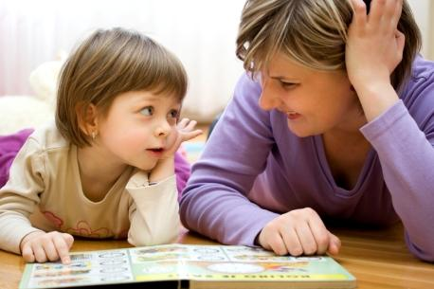
Parent survey results
96 Total Responses
Responses came from parents at BSU and local daycares in Boise
Results
71% of parents worked full time while 86% of their significant others also worked full time
67% of the parents had their infant in daycare throughout the week
65% of parents had a bachelor's degree or higher while 35% of the parents had an AA Degree or below (GED, high school diploma, no education)
56% of the parents read everyday while the rest read occasionally
97% of families owned books in their home (most had a tablet/iPad), but only 64% had appropriate books for their infant to read
Notes:
Dana

Slide 11
Parent survey results (con’t. )
83% of parents owned a library card, 39% had attended story time at the library with their infant, 93% said they would use a library card if they were given one
47% of parents expected their infant to be at a kindergarten reading level by kindergarten, the remaining 53% expected their infant to be at a higher level by kindergarten
63% read to their infant everyday, 21% read to their infant a few times a week, the remaining 16% rarely read to their infant
About half of the infants received less than two hours of screen time a day while the other half received none.
91% of parents prefered that their infant learn from a book rather than a tablet
30% of parents believed that their infant did not know the difference between a tablet and a book
Only 65% of the parents’ pediatricians mentioned the importance of reading to their infant
Notes:
Kristi

Slide 12
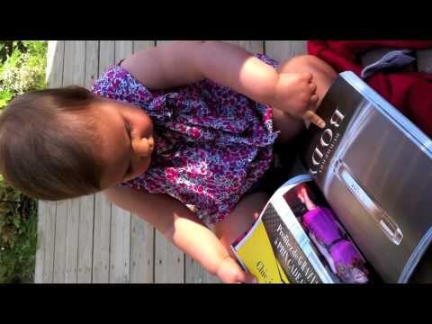
Notes:
Kristi

Slide 13
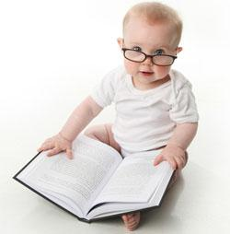
Recommendations for parents
Set an example for your infant!
make sure your infant or child sees you reading! This will make them want to read even more!
Take your infant to storytime!
Being able to hear an adult read to them in fun voices & different tones helps them understand dialogue (also gets them excited)
Infants benefit from watching other infants get engaged in a story
Exposes them to different authors & genres
They will slowly learn the basic classroom rules!
Check out your local Little Libraries to receive (free) donated books!
Or start one in your neighborhood!
Visit: http://littlefreelibrary.org/
Even though your infant cannot read, they still love to!
Babies love to touch and feel things
Picture books are awesome for learning shapes and animals!
Notes:
Dana

Slide 14
Recommendations for parents (con’t.)
Have less screen time and read more together! Everyday & every time counts!
Giving a child a tablet or iPad does not give them the parent to child experience they get with YOU while reading
Having that kind of connection is extremely important for building a future parent to child (trusting) relationship
If you do not have very many books at home, but have a tablet or iPad…
look up children books on Youtube!Users have uploaded them narrating the books in funny voices!
Don’t be afraid to ask your pediatrician for advice!
The more advanced your child is in reading, the better off they will be in school!
Start a parent-child book club with your friends and their kids!
Click here to learn how to start a parent-child book club
Remember the joy of reading!
Notes:
Dana

Slide 15
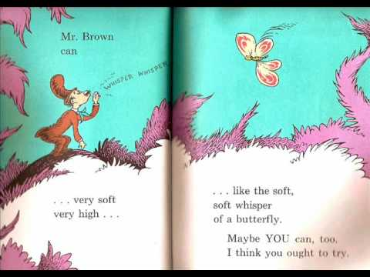

Slide 16
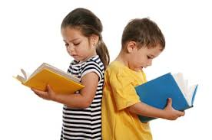
10 reasons to read!
A stronger relationship with you
Academic excellence
Basic speech skills
The basics of how to read a book
Better communication skills
Mastery of language
More logical thinking skills
Acclimation to new experiences
Enhanced concentration and discipline
The knowledge that reading is fun!
*click on title to go to article
Notes:
Kaylee

Slide 17
Libraries in Boise
Main Library
715 S. Capitol Blvd.
Tel: (208)972-8200
Library! At Cole & Ustick
7557 W. Ustick Rd.
Tel: (208)972-8300
Library! At Collister
4724 W. State St.
Tel: (208)972-8320
Library! At Hillcrest
5426 W. Overland Rd.
Tel: (208)972-8340
*Hours vary for each location
Notes:
Courtney

Slide 18
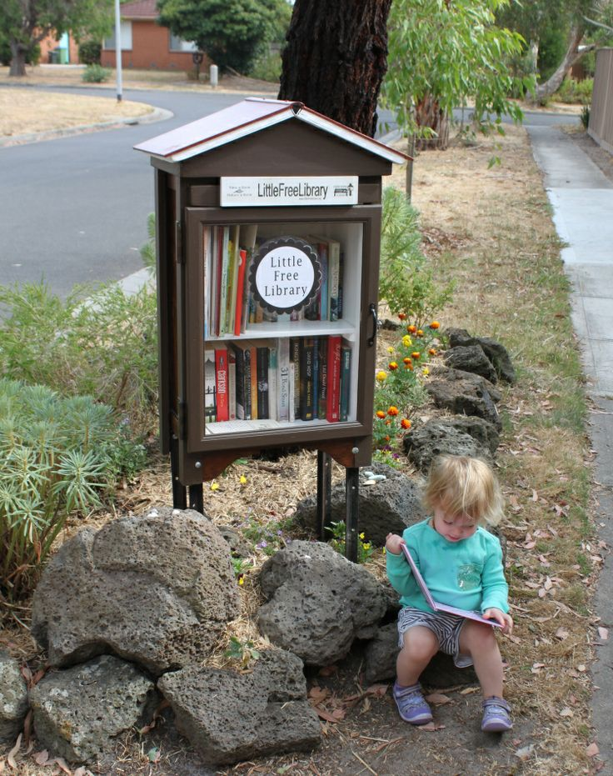
Little free Libraries in Boise
Charter #178
920 N. Balsam St.
Charter #9016
3609 W. Meadow Dr.
Charter #22506
1914 S. Broadway Ave.
Charter #10726
2003 Crystal Way
Notes:
Dana

Slide 19
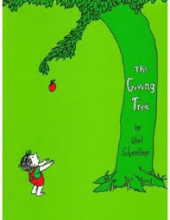
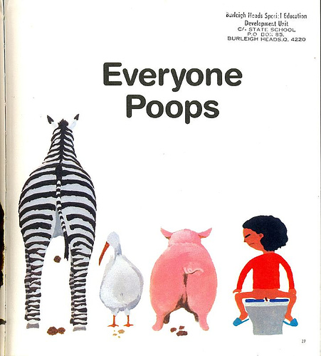
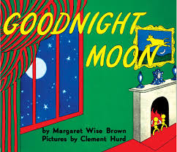
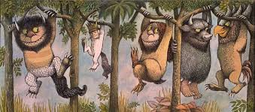
Dana’s Favorite children books
Everyone Poops by Taro Gomi
Dr. Suess’s Books:
The Cat in the Hat
Green Eggs and Ham
One Fish Two Fish Red Fish Blue Fish
Where the Wild Things Are by Maurice Sendak
Goodnight Moon by Margaret Wise Brown
The Giving Tree by Shel Silverstein
Notes:
Dana

Slide 20
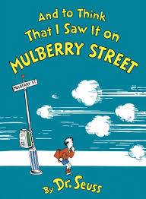
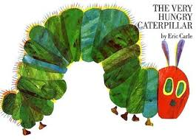
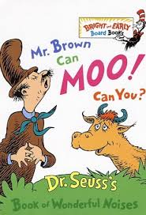
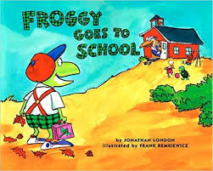
Kristi’s favorite children books
Mr. Brown Can Moo! Can You? by Dr. Seuss
And to Think That I Saw It on Mulberry Street by Dr. Seuss
Froggy Goes to School by Jonathan London
The Very Hungry Caterpillar by Eric Carle
Notes:
Kristi

Slide 21
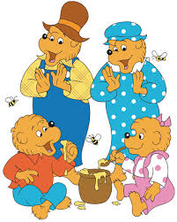
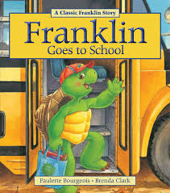
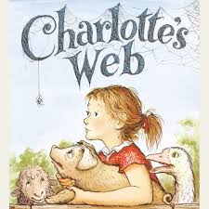
kaylee’s Favorite children books
Goodnight Moon by Margaret Wise Brown
Charlotte's Web by E.B. White
The Berenstain Bears by Stan & Jan Berenstain
Franklin the Turtle by Paulette Bourgeois & Brenda Clark
Notes:
Kaylee

Slide 22
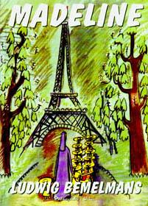
Courtney’s Favorite children books
Chicka Chicka Boom Boom by Bill Martin Jr. and John Archambault
Madeline by John Bemelmans Marciano and Ludwig Bemelmans
If You Give a Moose a Muffin by Laura Numeroff
Love You Forever by Robert Munsch
Notes:
Courtney

Slide 23
Thank you!

